Slide 1

Software Dependability
Ercolino Matteo: 0522501462
Silvestri Simone: 0522501419

Slide 2
Software Dependability
GSON
A Google’s library that provides an easy-to-use framework for converting Java objects to JSON (JavaScript Object Notation) representation and viceversa.

Slide 3
Software Dependability
GSON
4
148
11860
Modules
Classes
LOC

Slide 4
Software Dependability
GSON
4
Modules
Gson: It includes JSON parsers, serialization and deserialization classes, utilities, and supporting classes
Gson-protobuf: It allows serializing and deserializing Protocol Buffers objects
Gson-metrics: It allows colleting performance data and statistics during object serialization and deserialization
Gson-parent: It contains the Maven configuration file for the project and defines common dependencies and other basic configurations for the sub-modules

Slide 5
Software Dependability
Quality Analysis
We performed a software quality analysis by scanning the Github repository of the project using SonarCloud tool to discover bugs and code smells.

Slide 6
Software Dependability
Quality Analysis
3
6
7
Critical
Major
Minor

Slide 7
Software Dependability
Quality Analysis
3
6
7
Critical
Major
Minor
The critical bugs encompass a single issue that urges the renaming of a method to avoid any potential confusion with the Object.finalize() method.
Object.finalize() is called by the Garbage Collector at some point after the object becomes unreferenced.
Overloading Object.finalize() is a bad idea because the overload may not be called by the Garbage Collector and users are not expected to call Object.finalize() and will get confused. We fixed this bugs.

Slide 8
Software Dependability
Quality Analysis
3
6
7
Critical
Major
Minor
Regarding the major bugs, two issues involve the need to either override the Object.equals(Object obj) method or rename it entirely to prevent any confusion. Additionally, two other bugs relate to the naming conflict between a method in the current class and a private method in the parent class, requiring a renaming to ensure clarity.
Another major bug suggests using an "instanceof" comparison instead of comparing classes by name. But this is documented in the comment: "Class was added in Java 9, therefore cannot use instanceof". Therefore, we didn’t fix this bug.
Lastly, one major bug indicates the necessity to either rename a method or correct the type of the argument(s) to properly override a method in the parent class. We renamed the method from locationString to pathOfString.

Slide 9
Software Dependability
Quality Analysis
3
6
7
Critical
Major
Minor
Among the minor bugs identified, a noteworthy problem is the usage of Double Brace Initialization (DBI).
This technique creates an anonymous class with a reference to the instance of the owning object, which can potentially lead to memory leaks if the anonymous inner class is returned and held by other objects.
Moreover, DBI is considered obscure and can confuse most maintainers. To address this, it is recommended to use alternatives such as Arrays.asList for collections or explicitly adding each item directly to the collection

Slide 10
Software Dependability
GitHub Actions
To facilitate early bug detection, faster development cycles, and smoother deployments also to automate build, test, and deployment steps we setup a CI/CD environment using GitHub Actions.

Slide 11
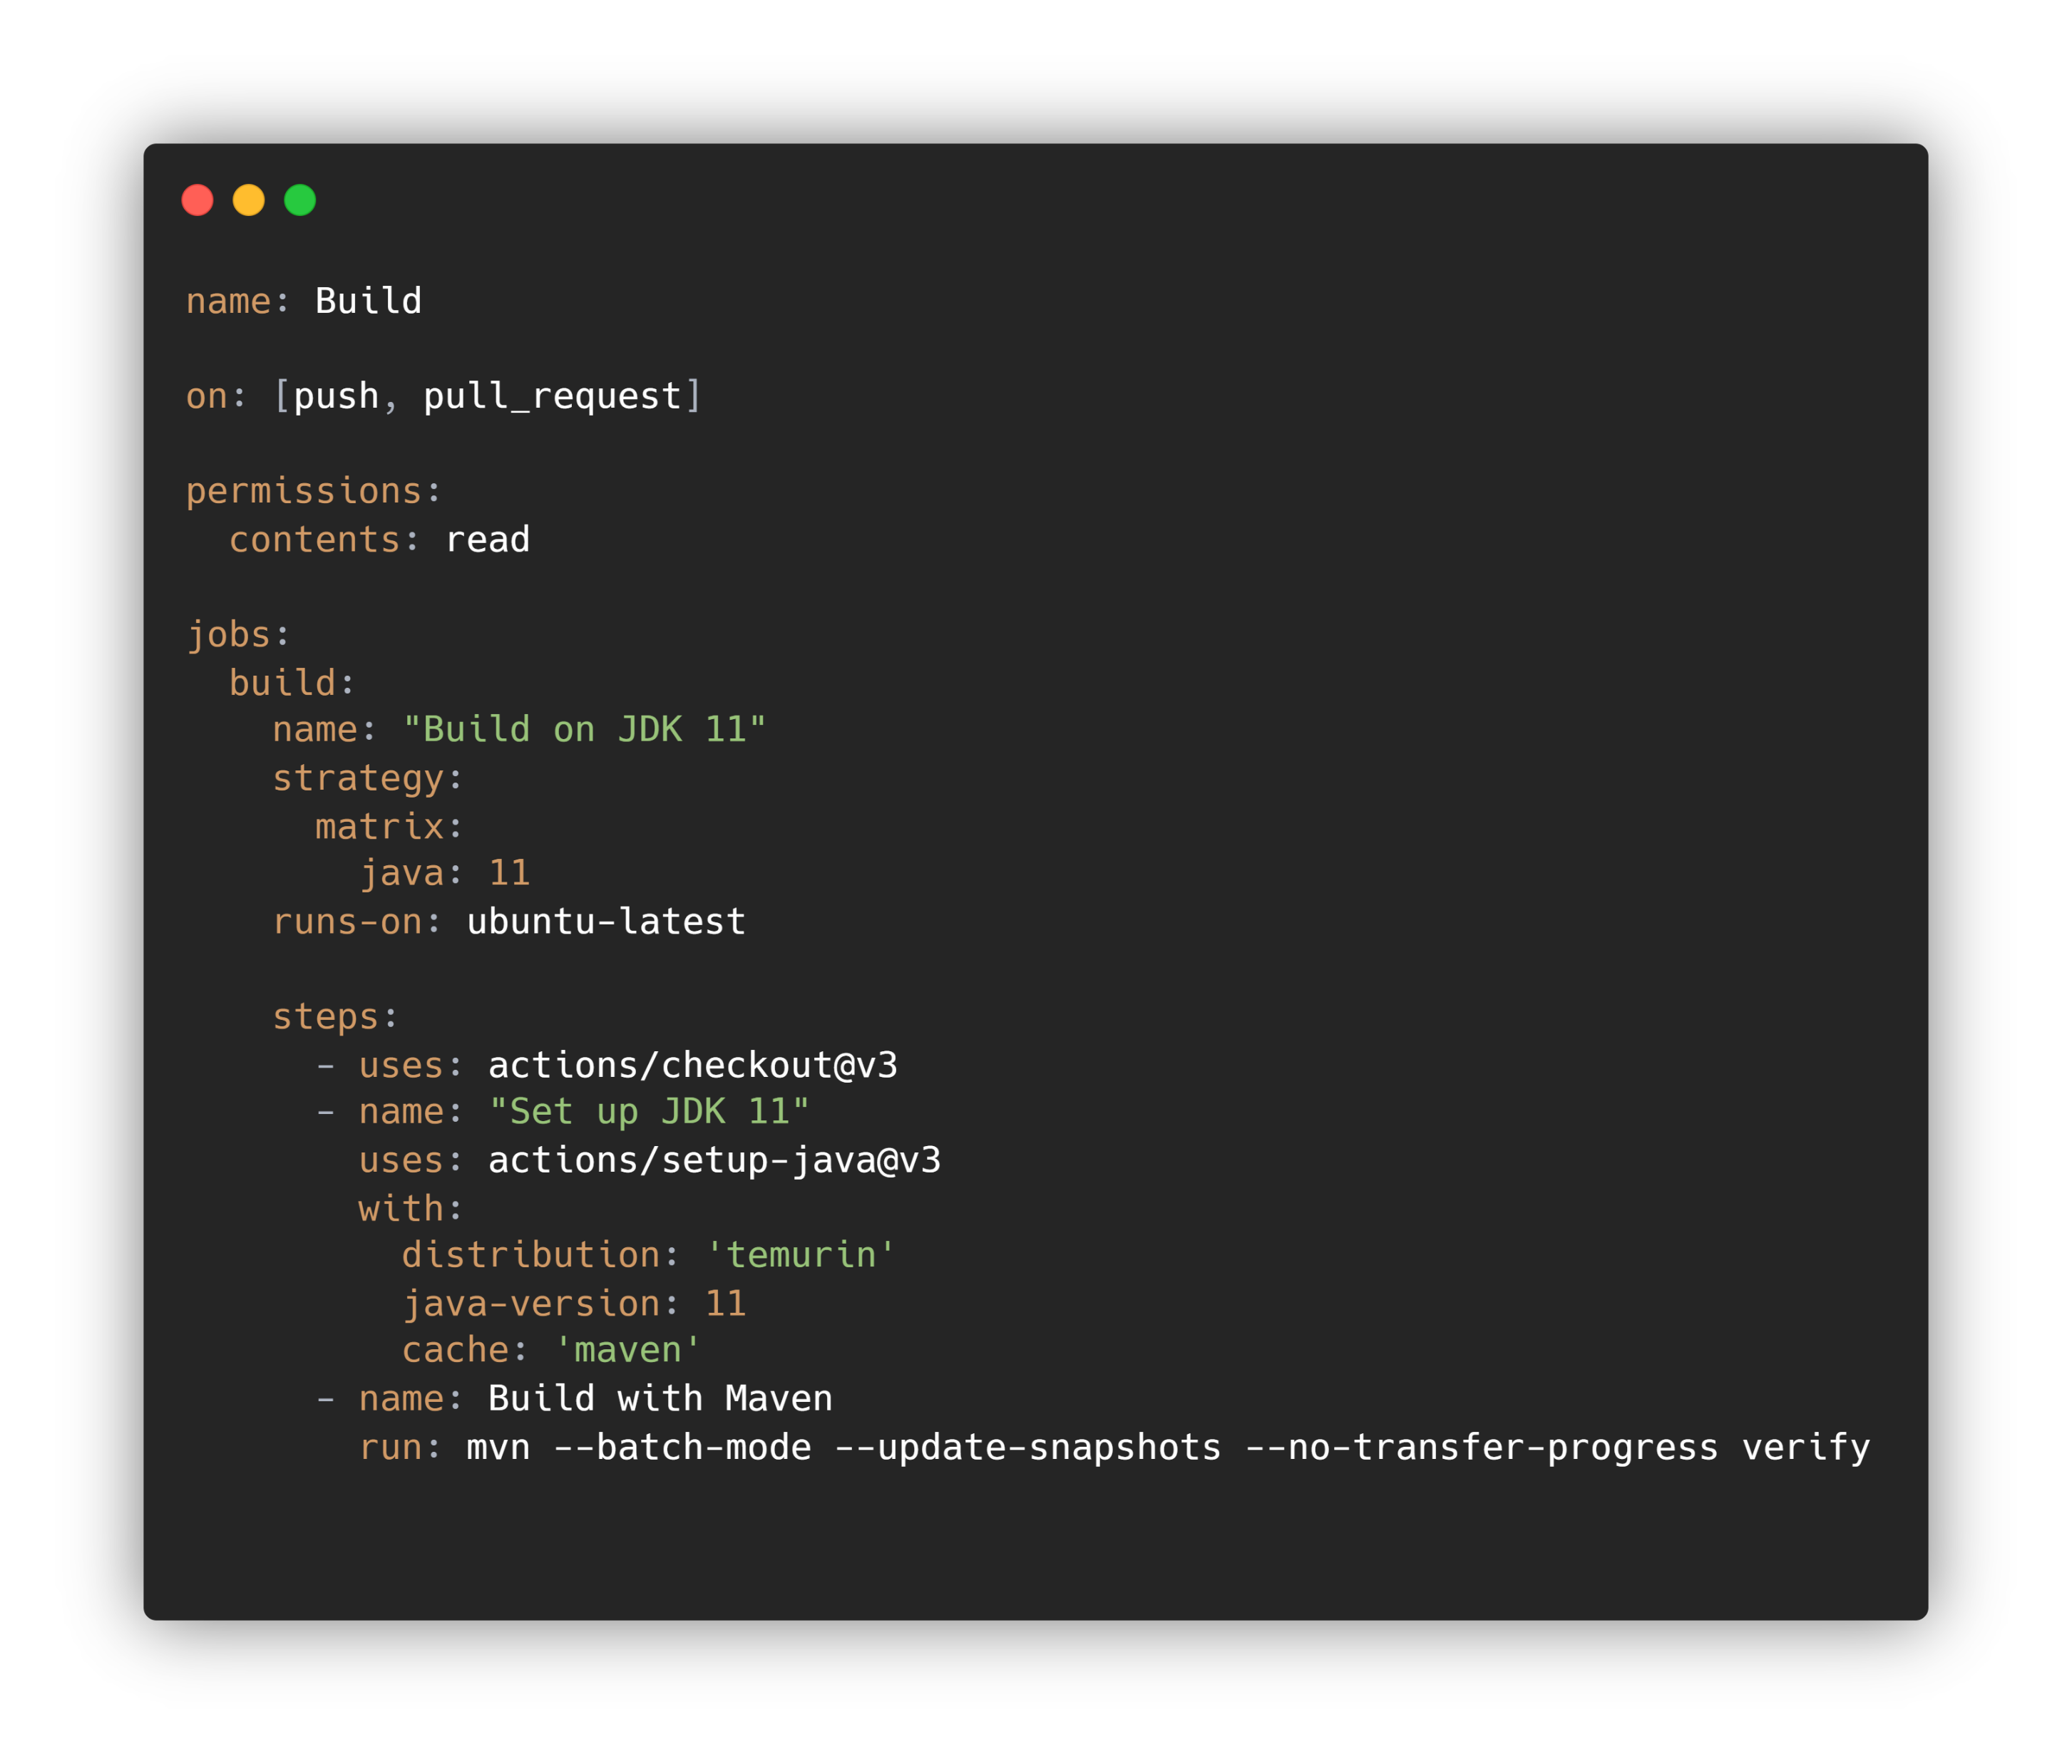
Software Dependability
GitHub Actions
1. We created a .github/workflows directory in our repository.
2. Defined a workflow YAML file “build.yml” to specify the desired workflow steps.
3. Configured the workflow triggers, such as on pushes to specific branches or pull requests.

Slide 12
Software Dependability
Docker
Docker is a platform designed to help developers build, share, and run modern applications.

Slide 13
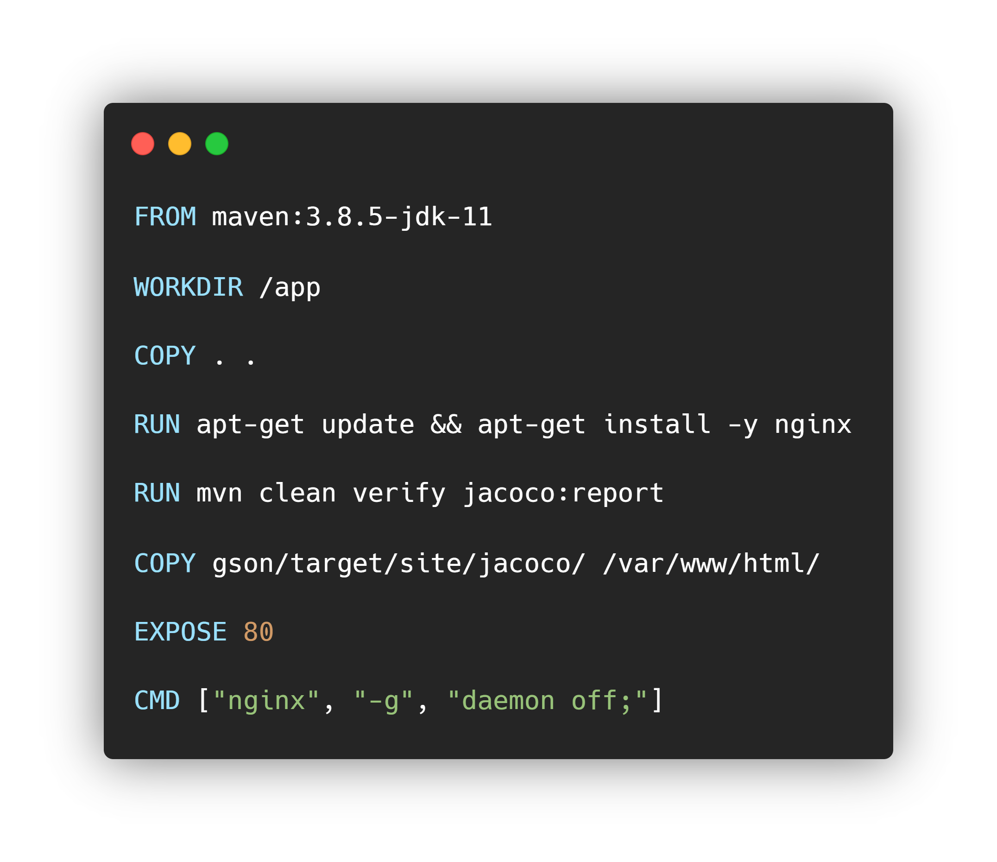
Software Dependability
Docker
We used Docker to configure our local build environment. Leveraging the power of Docker, we set up a streamlined workflow for build and testing our application.
Also, we choose to make a nginx server to expose coverage reports. Then we have made the resulting image available on DockerHub.

Slide 14
Software Dependability
Code Coverage Analysis
Code coverage analysis is a technique used to measure the proportion of code that is executed during testing. It helps determine how thoroughly a software application has been tested by identifying which parts of the code have been exercised and which parts have not.

Slide 15
Software Dependability
Code Coverage Analysis
To perform the code coverage analysis we have used Jacoco.
The results are that the test strategy choosen by Google team can reach a significant portion of the total product.
86%

Slide 16
Software Dependability
Code Coverage Analysis
To enhance the test effectiveness of Gson, we conducted a mutation analysis that takes the source code as input and applies modifications.
If a test that previously passed now fails, it indicates that the test is effective in detecting the introduced mutation.
We accomplished this goal using PiTest.
88%

Slide 17
Software Dependability
Energy testing
Energy testing is conducted to measure the energy consumption of a software or device and identify any inefficiencies that could be optimized to reduce environmental impact.

Slide 18
Software Dependability
Energy testing
The SonarQube analysis was performed on the specified codebase, focusing on code quality and energy-related issues.
While no bugs were found during the analysis, the presence of code smells indicates areas where the codebase could be further improved for energy efficiency. We fixed some code smells to remove unused variables, but others cannot be fixed because of false positives or a lack of budget.
In the context of energy testing, these code smells might suggest opportunities to optimize the code for better energy efficiency.
0
783
Bugs
Code smells

Slide 19
Software Dependability
Performance testing
Software performance testing is a practice that aims to evaluate the performance of an application or software system by measuring its speed, scalability, stability, and ability to handle the expected workload.

Slide 20
Software Dependability
Performance testing
The project already has a module (gson-metrics) that implements internal benchmark tests against Gson using Caliper, a tool for measuring Java code performance.
Nevertheless, we implemented our benchmarks with JMH because, as written in the GitHub repository of Caliper, it generally provides more accurate results than Caliper. We tested serialization and deserialization, both with three levels: easy, medium, hard.
Serialization
toJsonEasyPerson: 1.764 op/ns
toJsonMediumStudent: 0.010 op/ns
toJsonHardPersonBook: 0.016 op/ns
Deserialization
fromJsonEasyCar: 1.908 op/ns fromJsonMediumGarage: 0.029 op/ns
fromJsonHardLibrary: 0.009 op/ns

Slide 21
Software Dependability
Automatic Test Case
Generation
In order to improve the test quality in our project, we have used tools to automatically generate test cases.

Slide 22
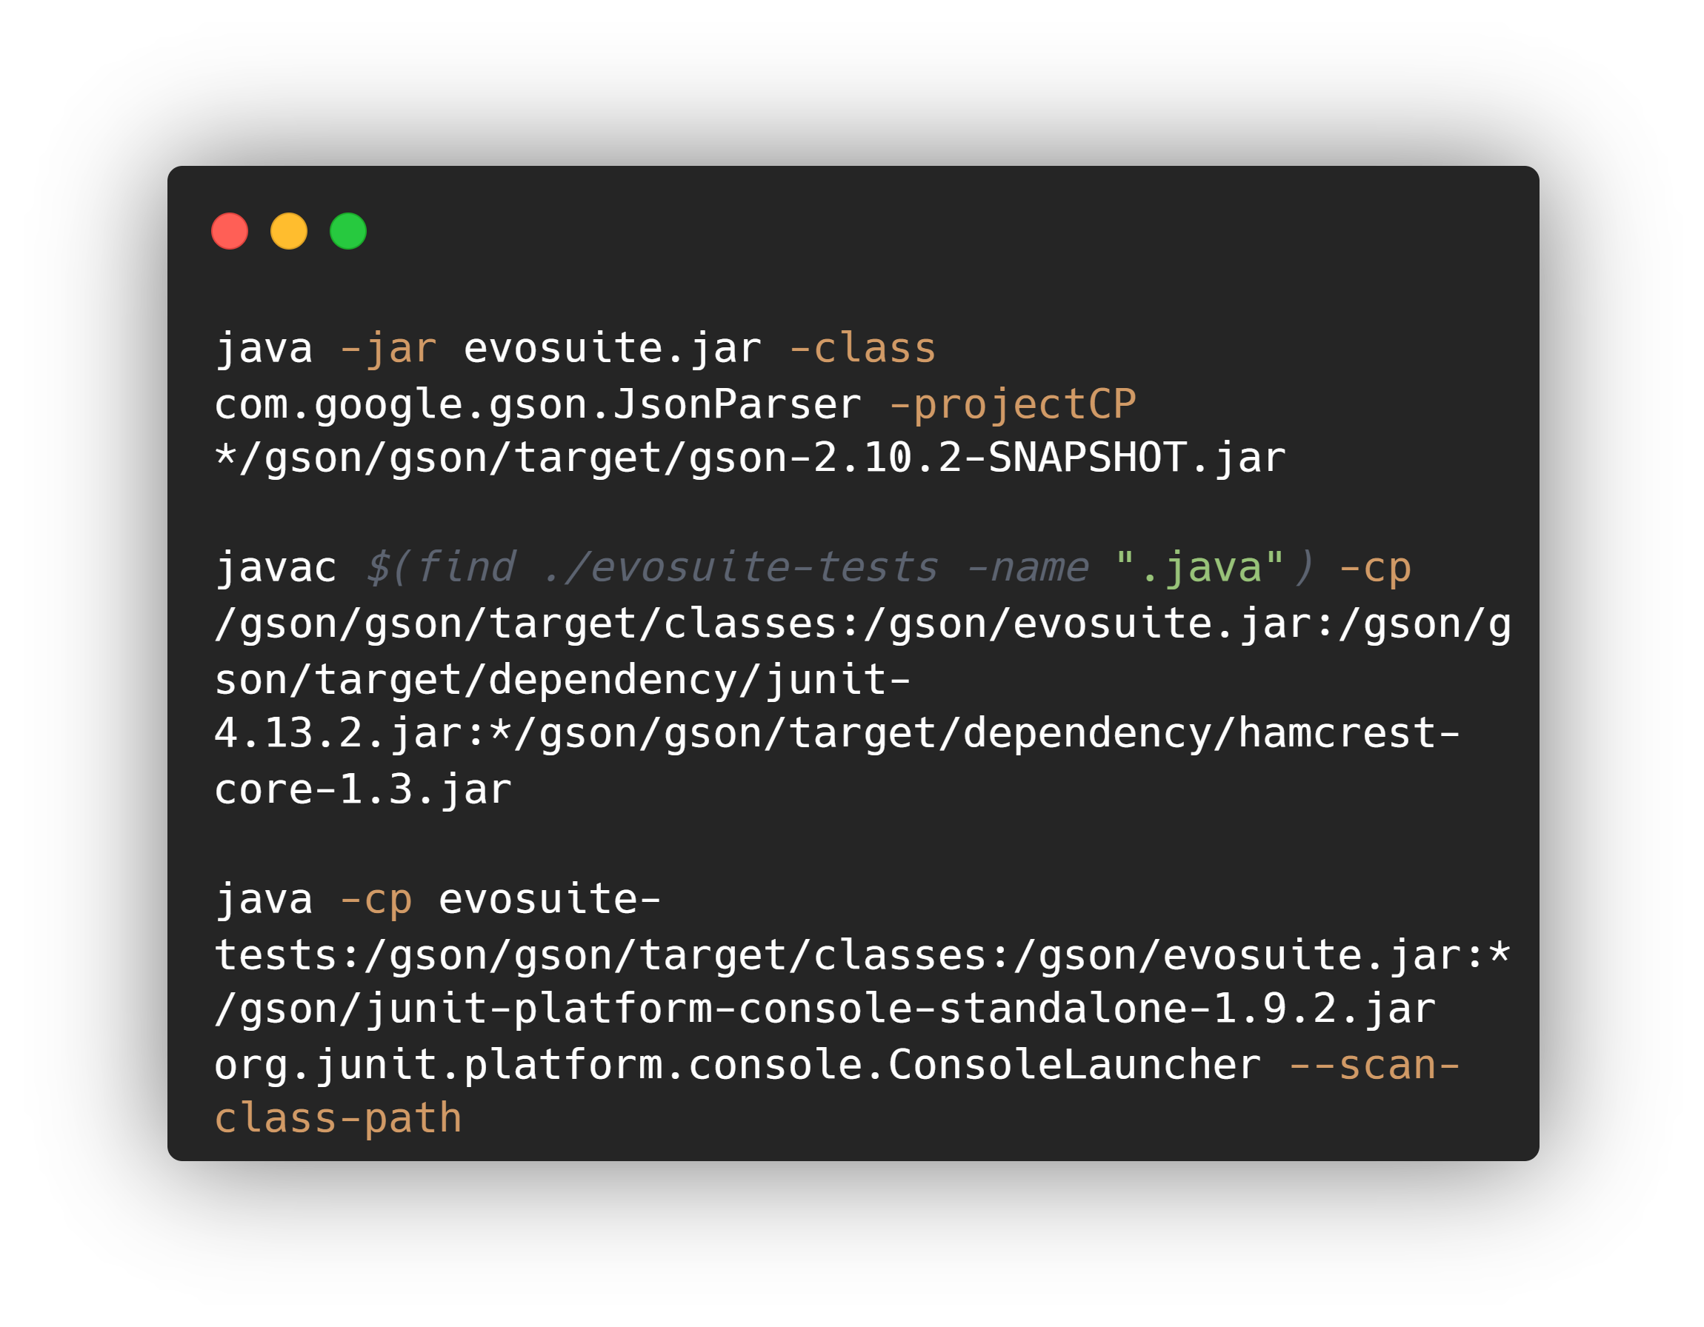
Software Dependability
Automatic Test Case Generation
1. We generated the automated tests using the Evosuite jar file from command line.
2. We compiled the generated test cases with javac command.
3. Finally, we executed the generated tests using the java -cp command. All tests were performed correctly without finding any bugs.

Slide 23
Software Dependability
Software vulnerabilities
Software vulnerability testing is an approach to identify and assess security weaknesses in software systems, aiming to uncover potential vulnerabilities that can be exploited by attackers.

Slide 24
Software Dependability
Software vulnerabilities
Vulnerability testing was conducted with Findsecbugs Findsecbugs conducted an extensive examination of the codebase, analyzing 6746 lines of code distributed among 219 classes and organized into 9 packages. We analyzed the jar file of the Gson module only since it is the only file that will be deployed for use.
The purpose of this analysis was to identify potential software vulnerabilities and highlight areas that may require attention.
The detected warning relates to a security vulnerability in the regular expression pattern:
"-?(?:0|[1-9][0-9]*)(?: ̇[0-9]+)?(?:[eE][-+]?[0-9]+)?“
which is susceptible to a denial-of-service attack (ReDOS).
1
0
Medium
High

Slide 25
Thanks for your attention
Made with ❤️

